Slide 1


A Subjective Dataset for Multi-Screen Video Streaming Applications
VQEG Spring Meeting 2023
June 26-30, 2023
Nabajeet Barman§*, Yuriy Reznik‡ and Maria Martini§
§Kingston University, London
‡ Brightcove Inc
*This work was done in part when first author was at Brightcove

Slide 2
Outline
Context and Objectives
Subjective Quality Assessment
Objective Quality Assessment
Conclusion and Future Work

Slide 3
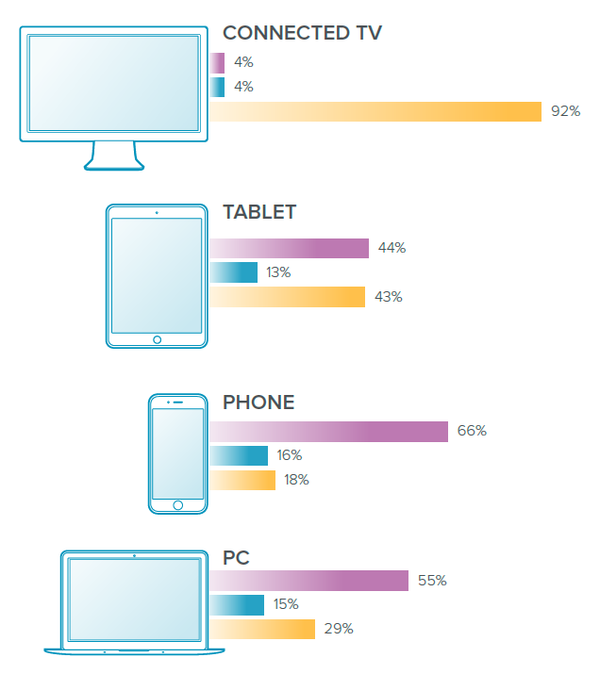


Typical Adaptive Streaming System
Origin
server
CDN
Stream 1
360p, 600k
Source Audio/Video
Encoder
Stream 2
480p, 1200k
…
Stream n
1080p, 4200k
ABR encoding ladder generator
Analytics System

Slide 4
Typical Adaptive Streaming System
Diversity of device capabilities and parameters
  perception of video on different devices is different
  different devices may pull different subsets of streams
  distribution of content usage across different devices may be different
  Existing Full-reference quality metrics - Not useful to streaming clients (as their values are usually unknown to the streaming clients)
We need datasets and quality models that can help estimate
  differences in perceived quality on different devices
  of use to streaming clients to make decisions such as selecting renditions

Slide 5


Multi-Screen Dataset
Problem : Lack of open-source datasets providing subjective scores for the same content when viewed on multiple devices with different screen sizes
QoE??

Slide 6
Contributions
Open-Source Multi-Screen Dataset consisting of:
  Source and Encoded Videos
  Subjective scores considering three different devices (Mobile, Tablet and TV)
  Individual and mean opinion scores
  Participant Demographics
  Evaluation of existing VQA metrics
Notes:
Individual subjective scores
MOS
Demographics

Slide 7
Potential Applications
Gaining insight into the effect of different screen sizes on the viewing experience of the end user;
Evaluating the performance of existing VQA algorithms and methods (e.g., quality metrics) considering a multiscreen streaming environment;
Design of new parametric models and metrics taking into account differences in perception due to varied screen sizes;
Cross-lab evaluation and comparison of subjective quality assessment studies.

Slide 8

SUBJECTIVE ASSESSMENT
Notes:
So, what did we do…..

Slide 9
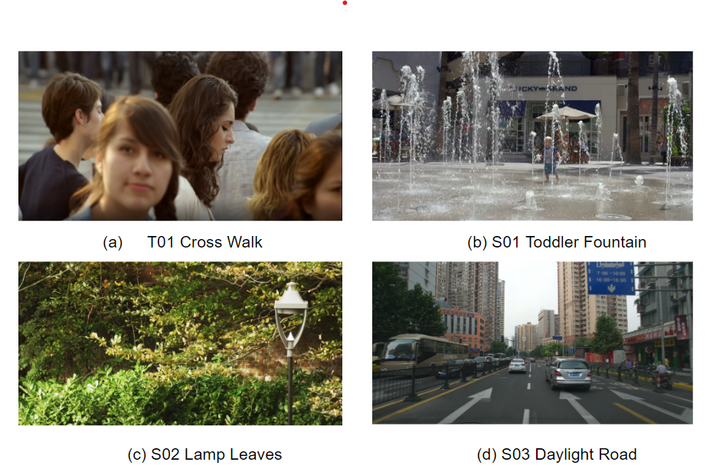
Screenshot of Source Sequences
Notes:
Five seconds duration

Slide 10
Summary of Video Encoding Settings
Parameter | Value
Duration | 5 sec
Resolution | 1080p, 720p, 540p
Dynamic Range | SDR (BT.709)
Framerate | 60
Encoder | Zencoder§
Encoding Mode | Brightcove’s CAE‡
Codec/Profile | HEVC (Profile: Main)
§https://www.brightcove.com/en/products/zencoder/
‡https://zencoder.support.brightcove.com/general-information/overview-context-aware-encoding.html

Slide 11
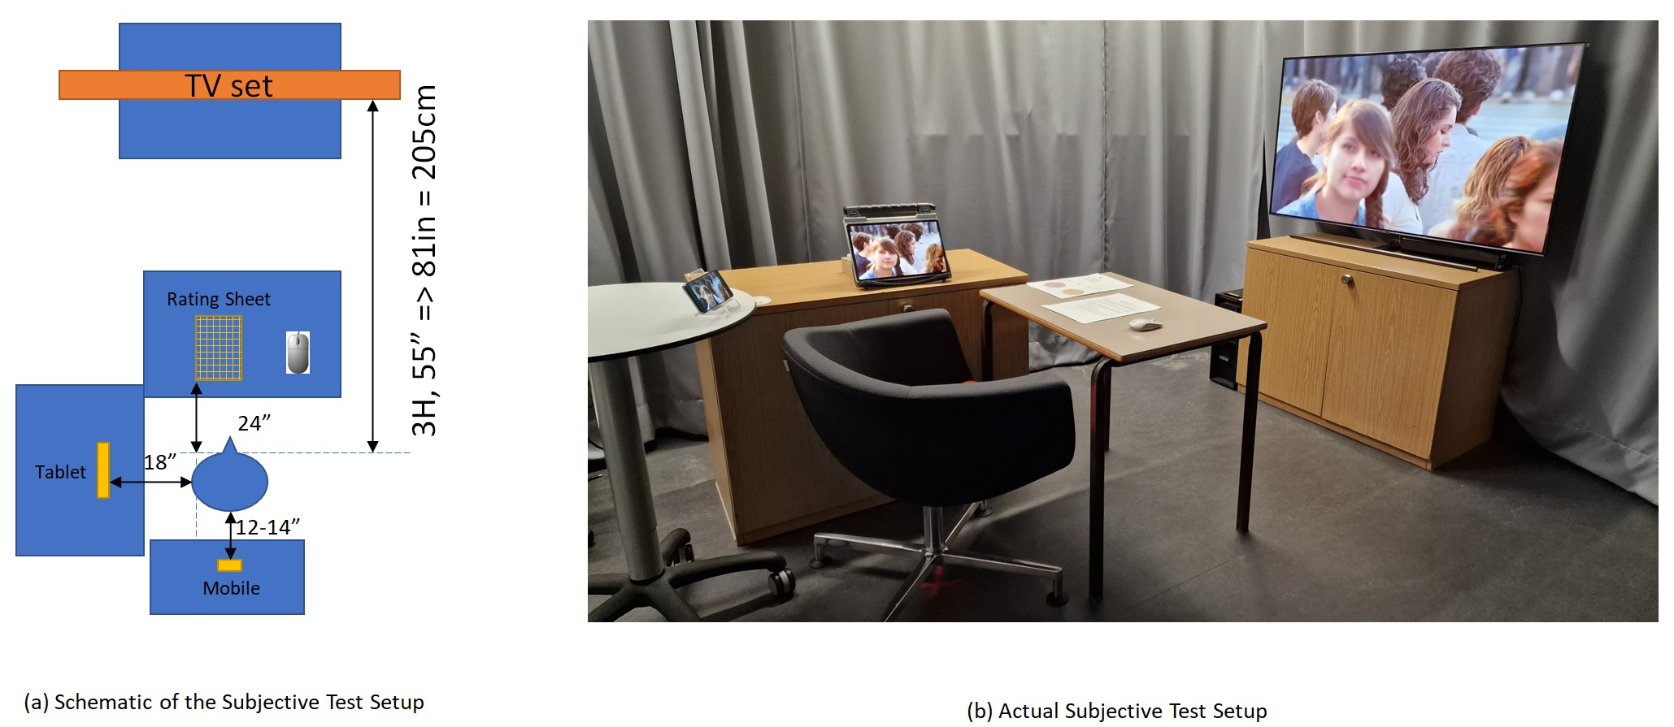
Subjective Test Lab Setup
(a) Schematic
(b) Actual
Notes:
CAVE Lab at Kingston University, London
Same manufacturer for consistency in display and playback (VLC player)
1) TV: 55′′ Samsung Q9F Flagship QLED 4K Certified Ultra HD Premium HDR 2000 Smart TV powered by HDR10+
2) Tablet: 12.4-inch Samsung Tablet with 2800 x 1752 (WQXGA+) resolution super amoled display
3) Mobile: 6.1′′ Samsung Galaxy S21 5G smartphone with device resolution of 2400x1080 pixels.

Slide 12
Test Methodology
Rating: ACR 1-5
Training Session
Test Session
Self-paced
Playback using VLC, full screen mode
Repetition Allowed

Slide 13
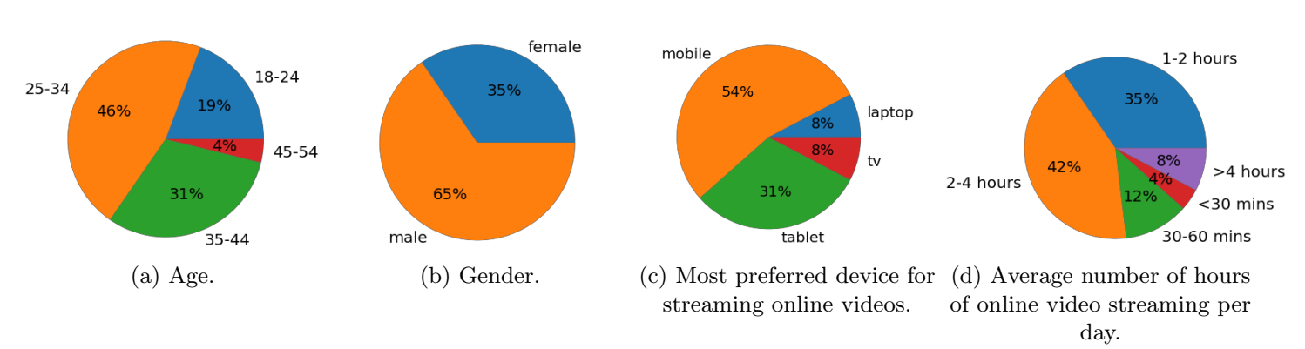
Test Participants Demographics
Notes:
26 test participants took part in the study, with 17 male and nine female test participants.

Slide 14
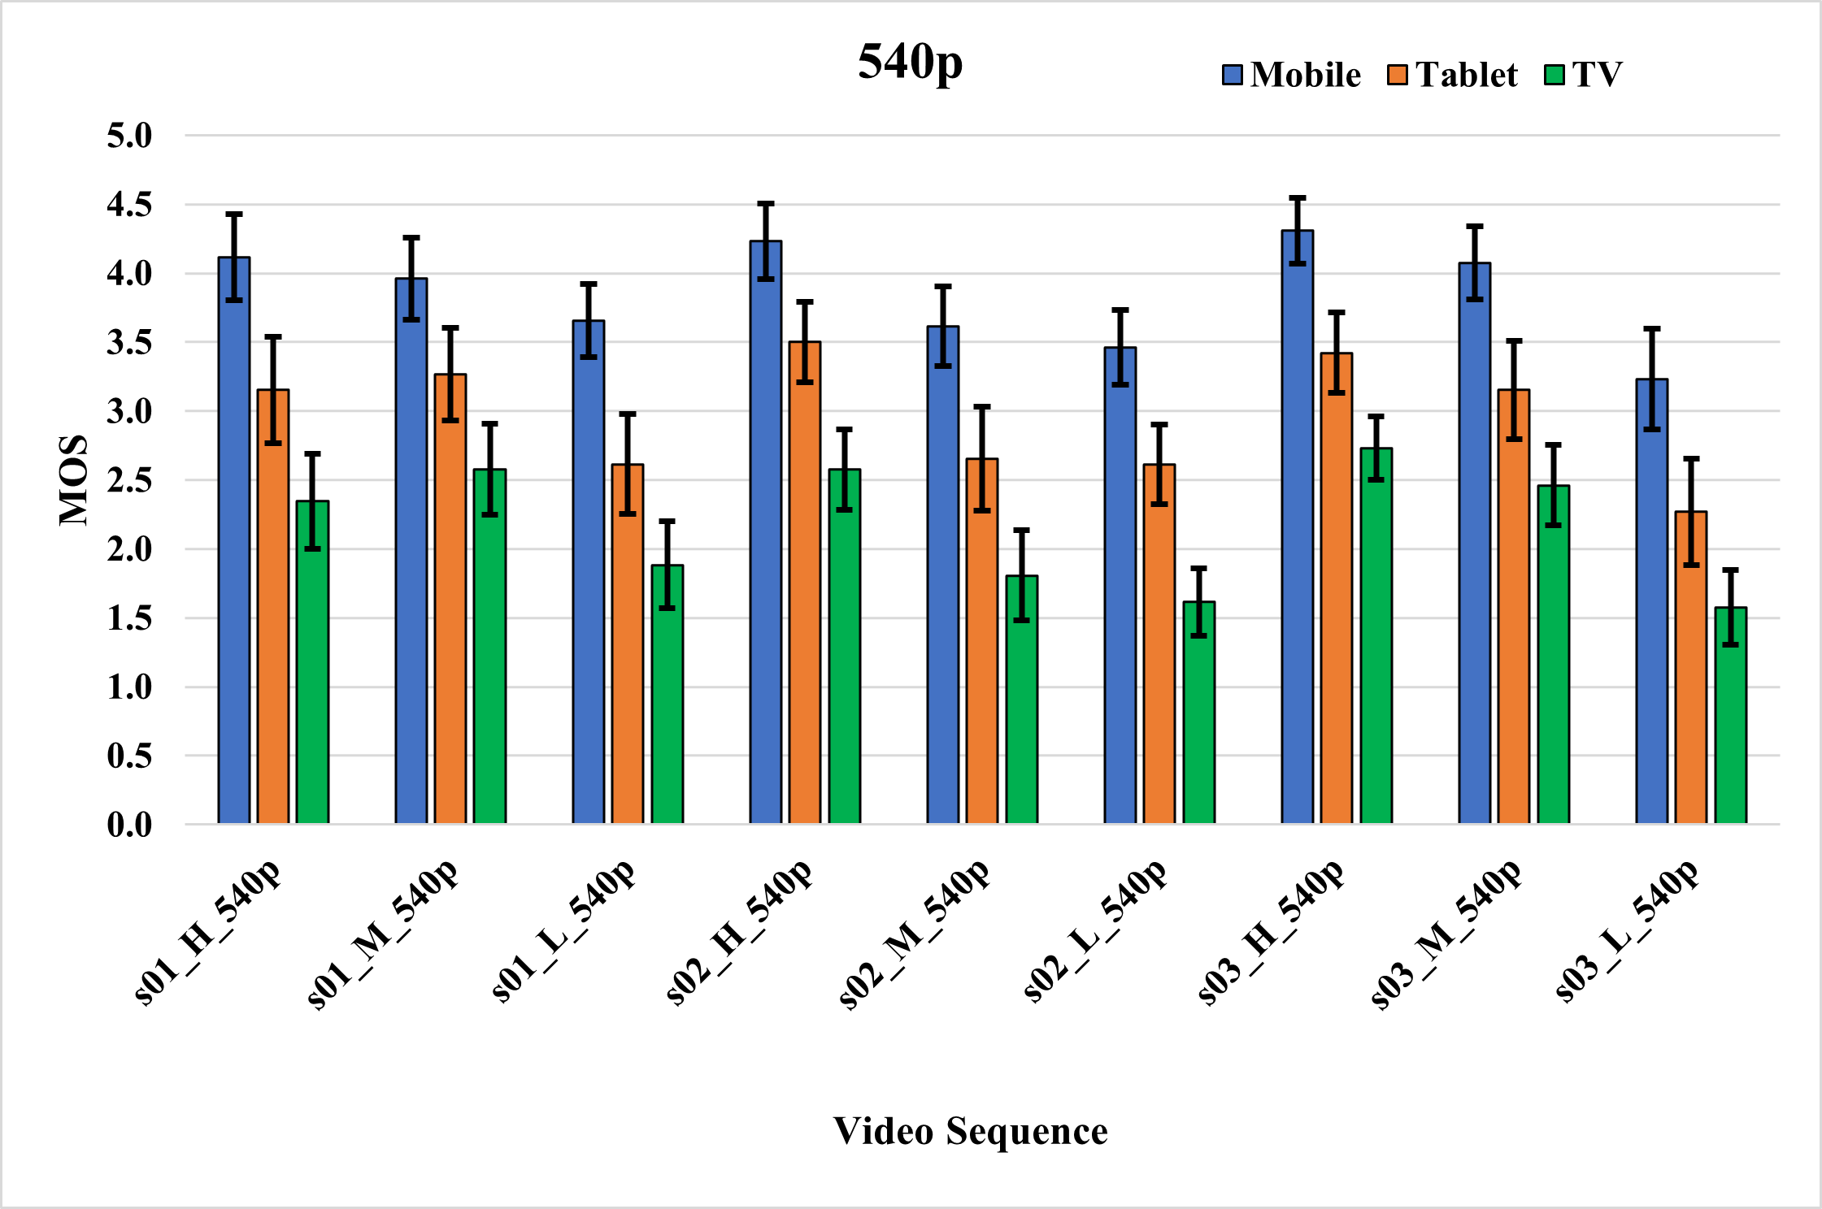
MOS (with 95% confidence interval) for all 540p Sequences

Slide 15
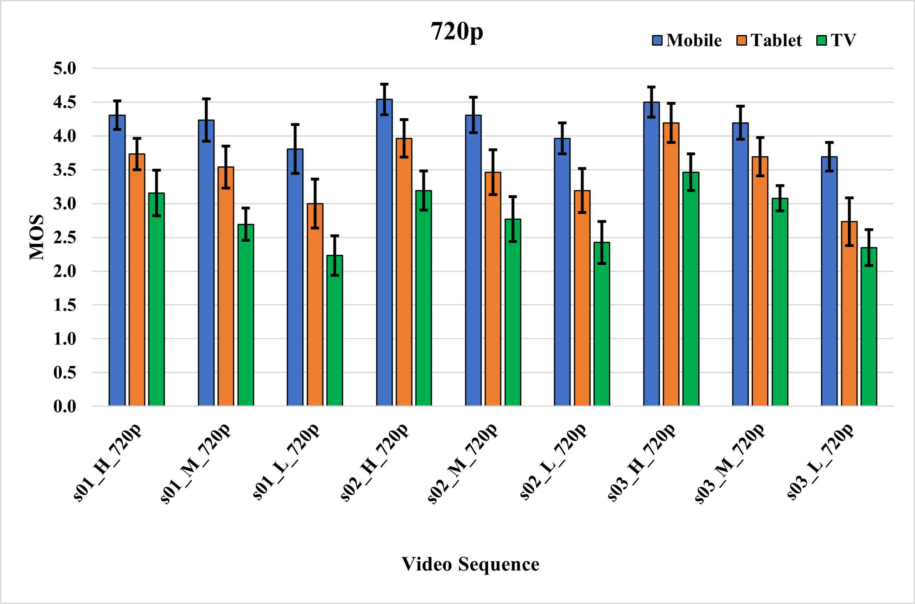
MOS (with 95% confidence interval) for all 720p Sequences

Slide 16
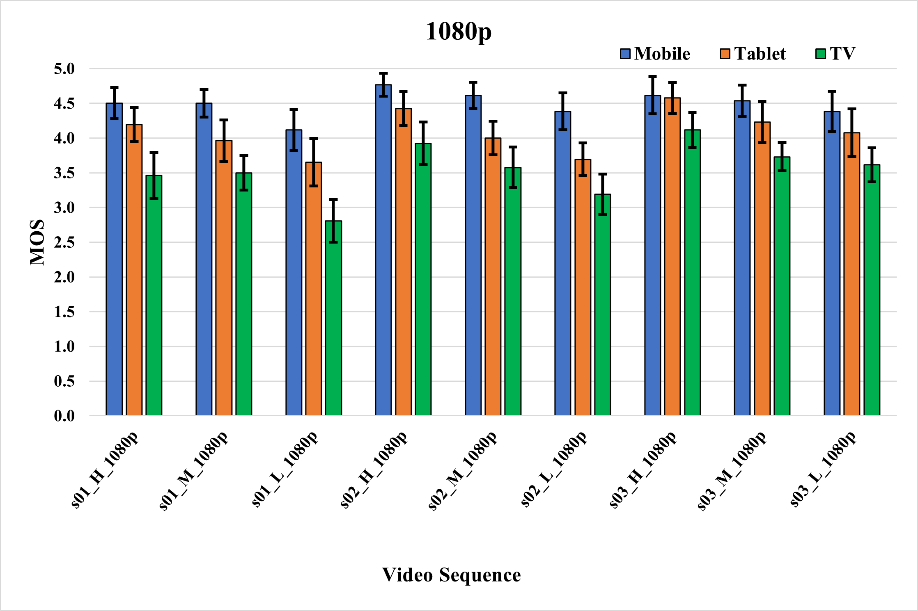
MOS (with 95% confidence interval) for all 1080p Sequences

Slide 17
MOS Plots – Summary
A particular video sequence is almost always rated the highest on a mobile device.
  Tablet devices receive a slightly lower rating than mobile.
  Larger screen, such as a TV, the rating for the same video can be quite low.
In general, even the lowest-quality videos were rated at least “fair” (3 MOS) on a mobile device.
The differences in quality for the 1080p resolution renditions considering each device individually, is more prominent for lower-quality encodes as compared to medium and high-quality encodes of the same video.
At lower encoded resolutions (720p and 540p), the differences in quality when considering different devices is more prominent for 540p resolution, especially for mobile and tablet devices

Slide 18

OBJECTIVE ASSESSMENT
Notes:
So, what did we do…..

Slide 19
Comparison of the Performance of Various VQA Metrics – PLCC, SROCC, RMSE
Device | PLCC |  |  |  |  | SROCC |  |  |  |  | RMSE
 | PSNR | SSIM | VIF | VMAF | P1204.3 | PSNR | SSIM | VIF | VMAF | P1204.3 | PSNR | SSIM | VIF | VMAF | P1204.3
Mobile | 0.56 | 0.68 | 0.81 | 0.83 | 0.86 | 0.56 | 0.71 | 0.82 | 0.80 | 0.82 | 0.32 | 0.29 | 0.23 | 0.22 | 0.20
Tablet | 0.65 | 0.72 | 0.85 | 0.86 | 0.89 | 0.65 | 0.76 | 0.85 | 0.86 | 0.89 | 0.49 | 0.44 | 0.34 | 0.32 | 0.29
TV | 0.68 | 0.77 | 0.85 | 0.86 | 0.85 | 0.65 | 0.77 | 0.85 | 0.82 | 0.81 | 0.54 | 0.47 | 0.39 | 0.38 | 0.39
Notes:
VMAF default model was used in all three device cases. Phone model computation requires some workaround and is currently a work in progress.
P.1204.3 was computed twice – once for the tablet/mobile case, once for the TV case

Slide 20
Performance of VQA Metrics – Summary
P1204.3 performs quite well across different devices, often at par with FR metrics.
VMAF performs best for TV device cases, considering all three performance measures. Phone model not evaluated so far (work in progress)
VIF performs quite close to VMAF across all three devices.
PSNR and SSIM, as expected, do not perform that well.

Slide 21
CONCLUSION AND FUTURE WORK

Slide 22
Future Work
Evaluate the VMAF phone model and additional metrics
Increased number of source sequences (of resolution up to 8K),
  Higher bit-depth (10-bit) and dynamic range (HDR).
Development of parametric models that can adapt to differences in screen sizes/device type without the need for re-computation for each device type!
Notes:
Basically address the current limitations and improve the scope

Slide 23
Thanks
Co-Authors, Dr Yuriy Reznik and Prof Maria Martini
Brightcove (funding and technical support)
Kingston University (test laboratory and devices)
Dr Arslan Usman (device)
Test Participants (staff, current and former students)

Slide 24

Nabajeet.Barman@kingston.ac.uk

